Slide 1
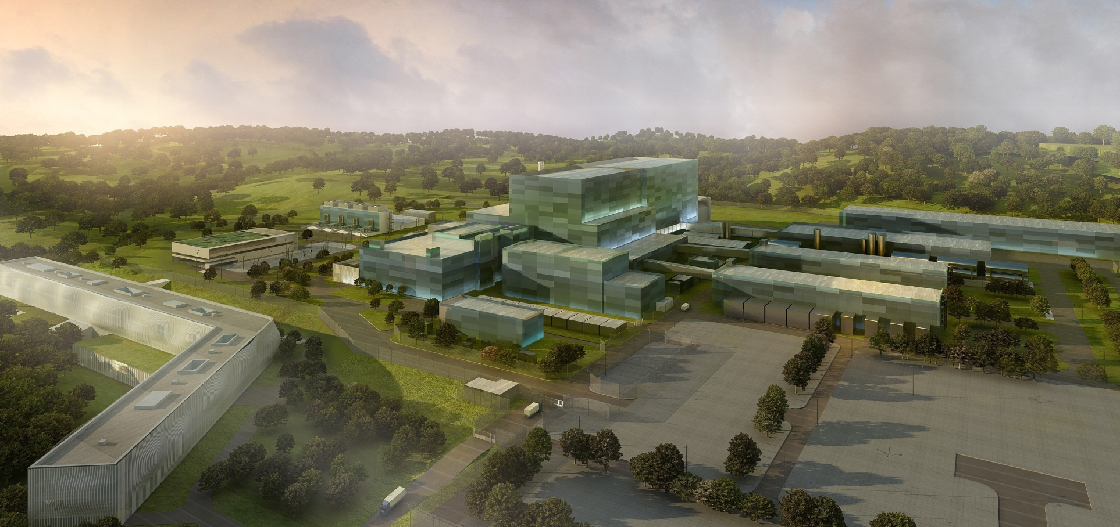
Status of ITER and CODAC
Ralph Lange
ITER Organization
Control System Division

Slide 2
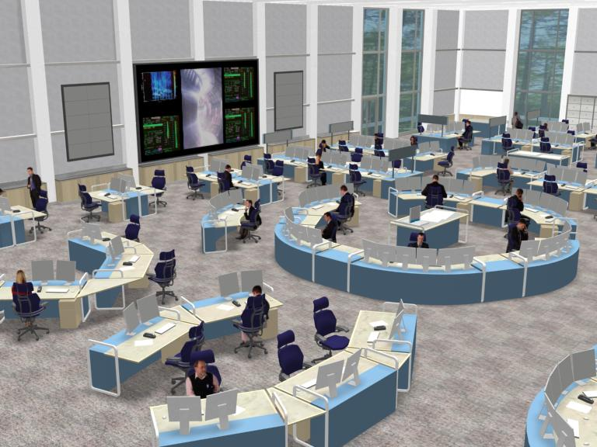
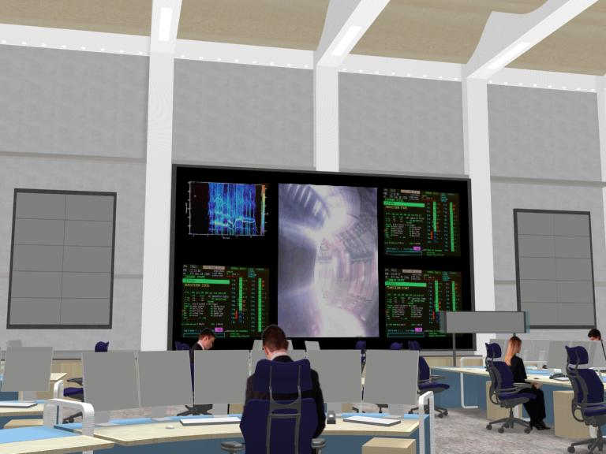
The Final Goal: Integrated Operation
B71 Control building
Artist view of ITER control room
(courtesy AOP)

Slide 3
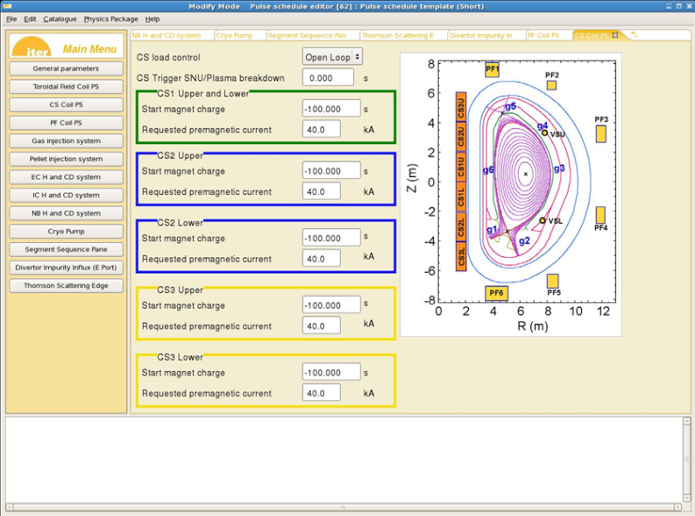
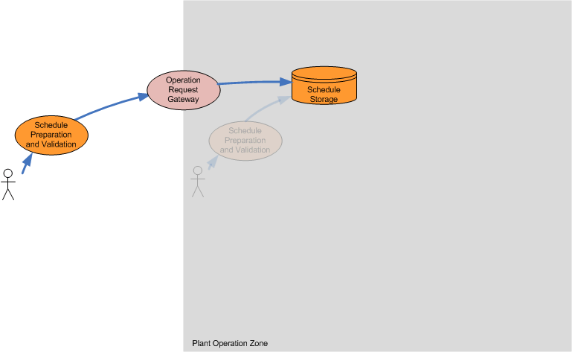
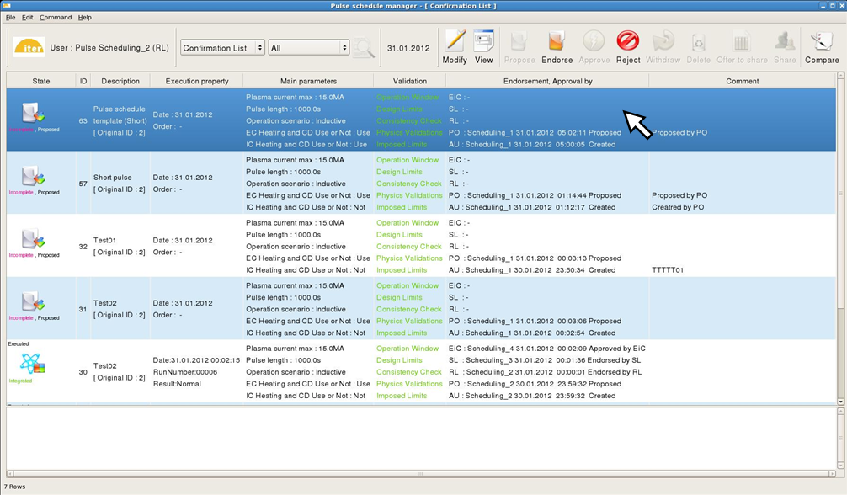
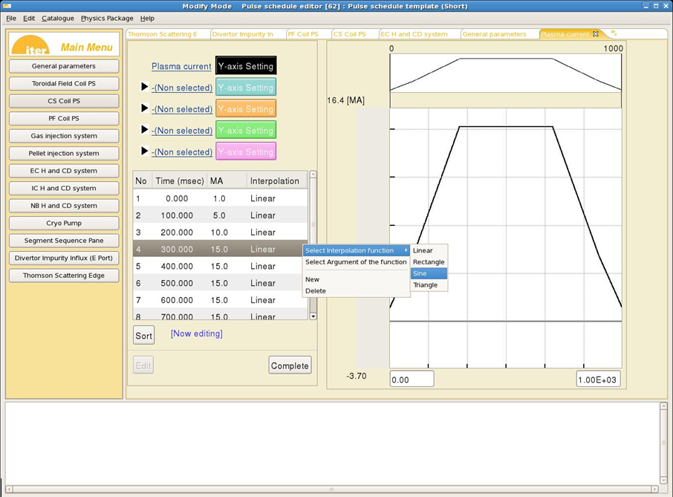
Step 1 : Prepare the operation schedule off-line

Slide 4
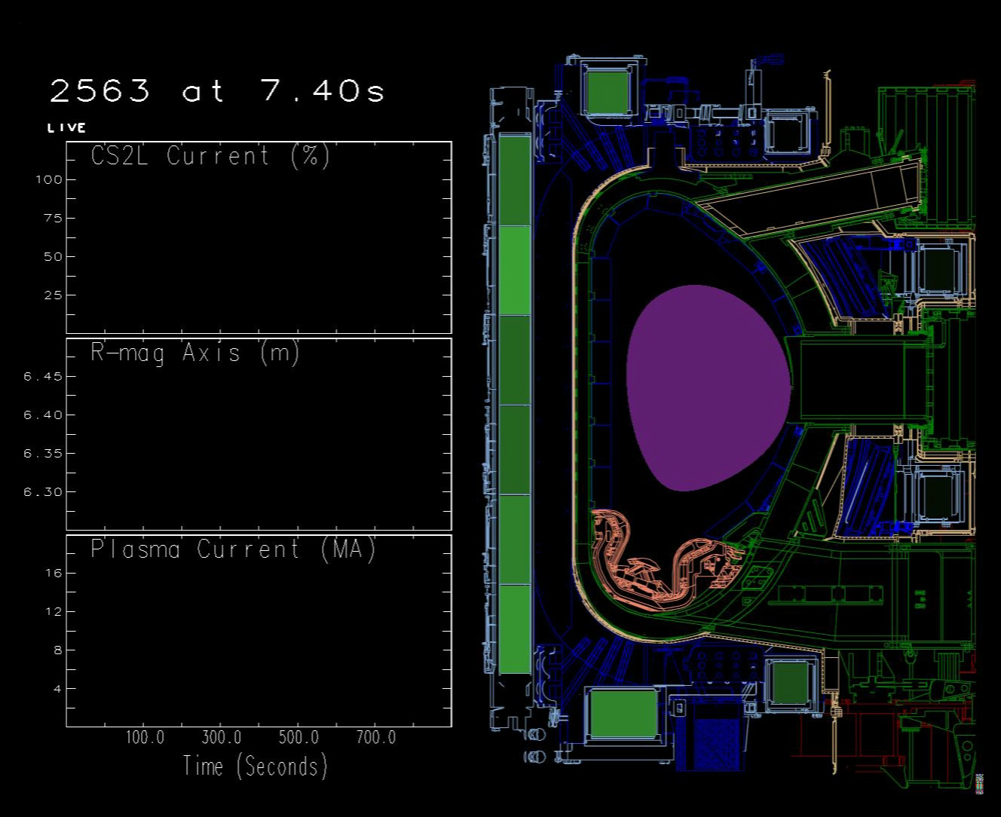
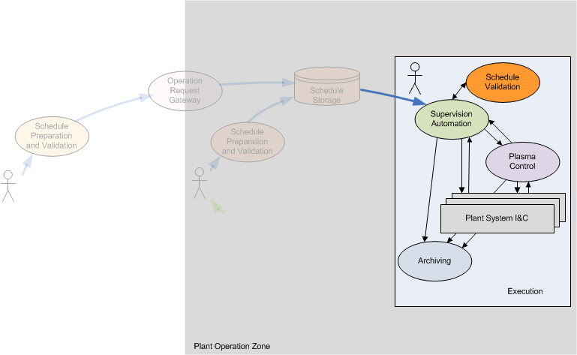

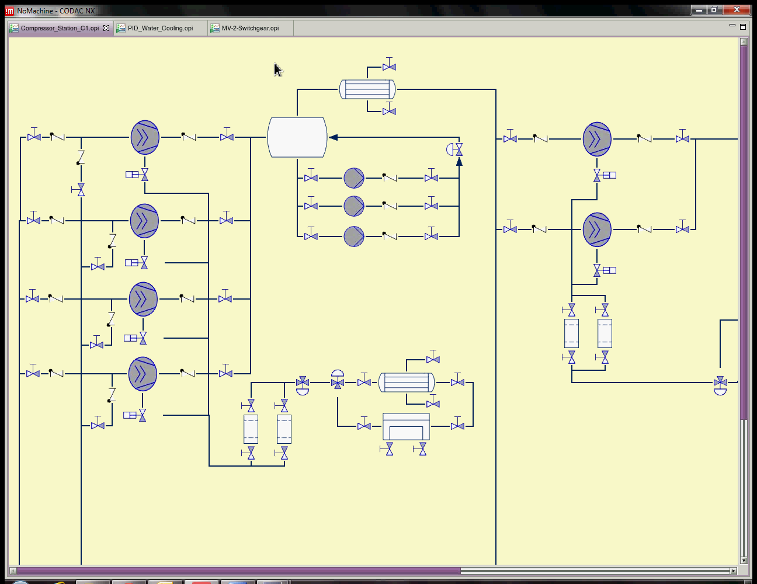
Step 2 : Execute

Slide 5
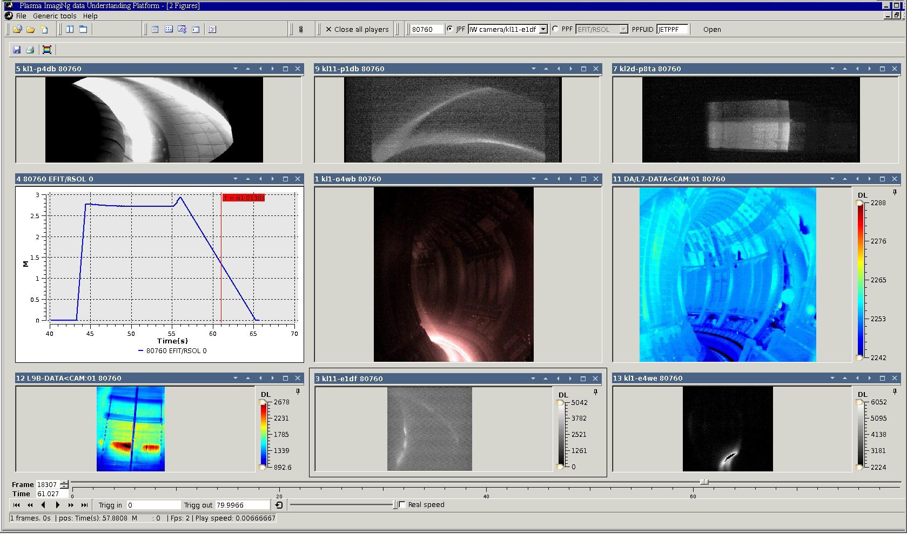
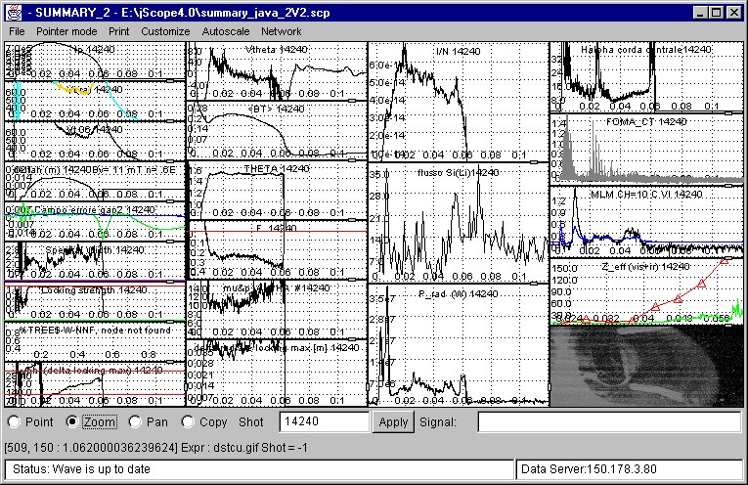
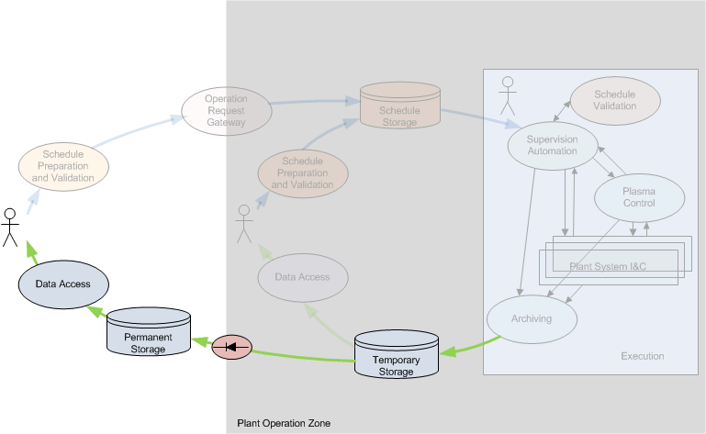
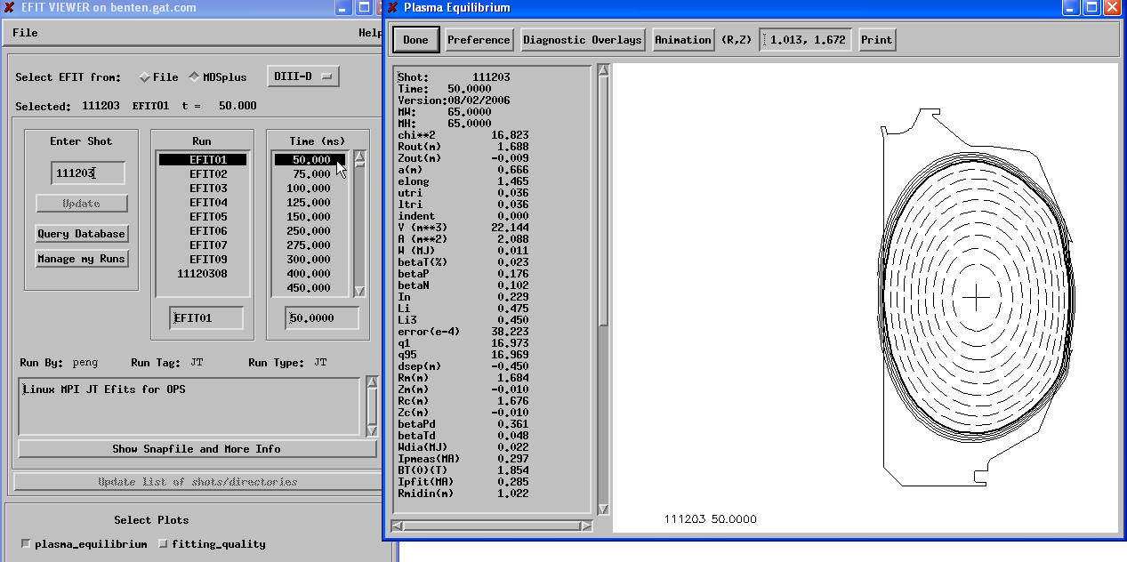
Step 3 : Analyze the data

Slide 6
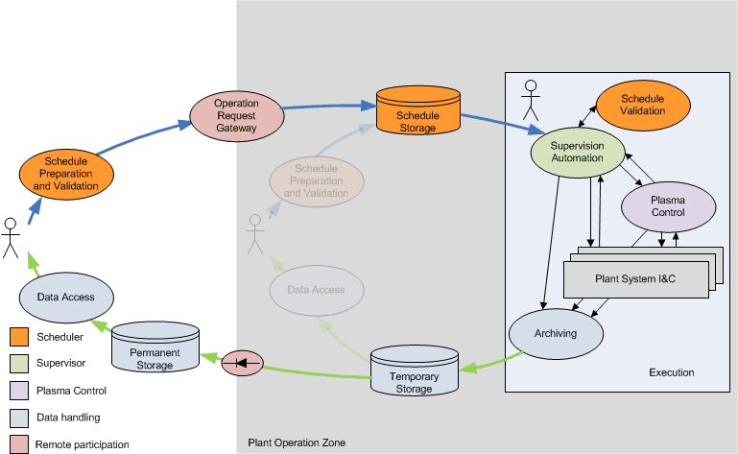
Data Flow Model
Preparation
Execution
Analysis
To reach the goal all systems need to communicate

Slide 7
Many different networks for different purposes
All, except nuclear safety and quench loop, based on Ethernet
Plant Operation Network (PON)
General purpose command, status, archive,… (Gbps Ethernet)
Synchronous Databus Network (SDN)
Distributed feedback control (10 Gbps UDP multi-cast)
Time Communication Network (TCN)
Absolute time synchronization (IEEE 1588 2008)
Data Archiving Network (DAN)
High volume data archiving (10 Gbps Ethernet)
Central Interlock Network (CIN)
Industrial Ethernet, Hardwired
Central Safety Networks (CSN)
Industrial Ethernet, Hardwired
Mainstream industrial standards

Slide 8
CODAC Parameters
Parameter | Value
Total number of computers | 1.000
Total number of signals (wires) | 100.000
Total number of process variables | 1.000.000
Maximum sustained data flow on PON | 50 MB/s
Total PON archive rate | 25 MB/s
Total DAN archive rate (initial) | 2 GB/s
Total DAN archive rate (final) | 50 GB/s
Total archive capacity | 90-2200 TB/day
Accuracy of time synchronization | 50 ns RMS
Number of nodes on SDN | 100
Maximum latency asynchronous events | 1 ms
Maximum latency application to application (SDN) | 50 µs
Maximum sustained data flow on SDN | 25 MB/s
Achievable with today’s COTS technology

Slide 9
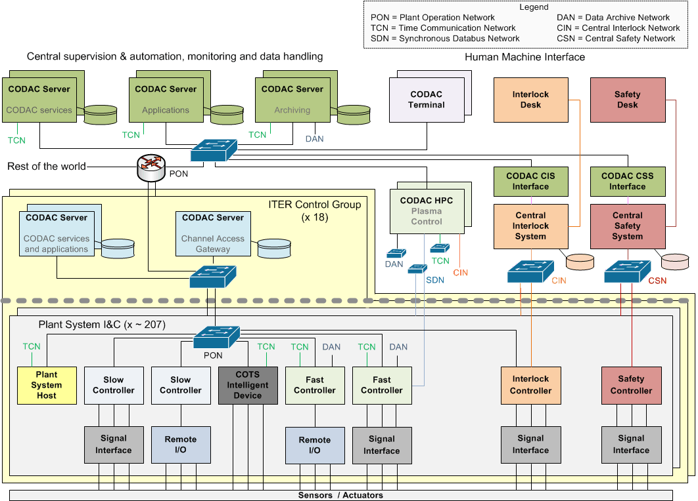
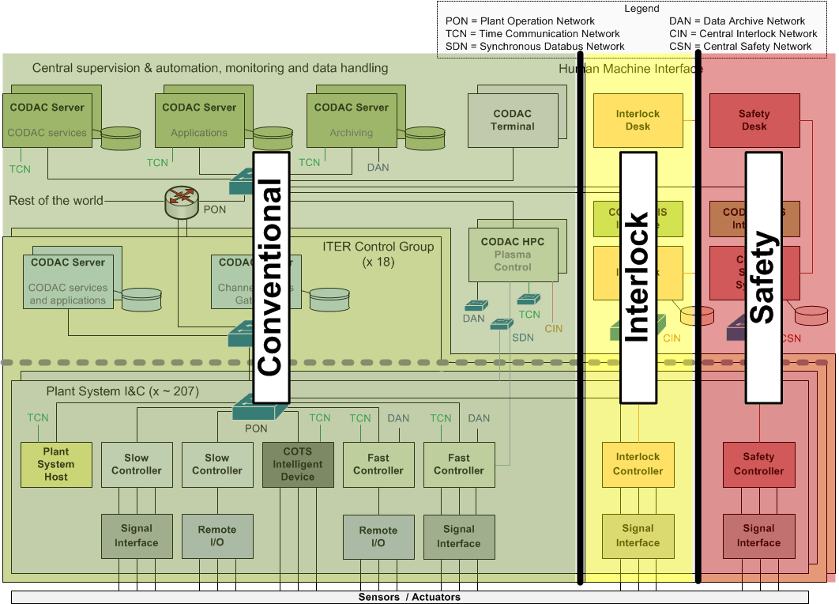
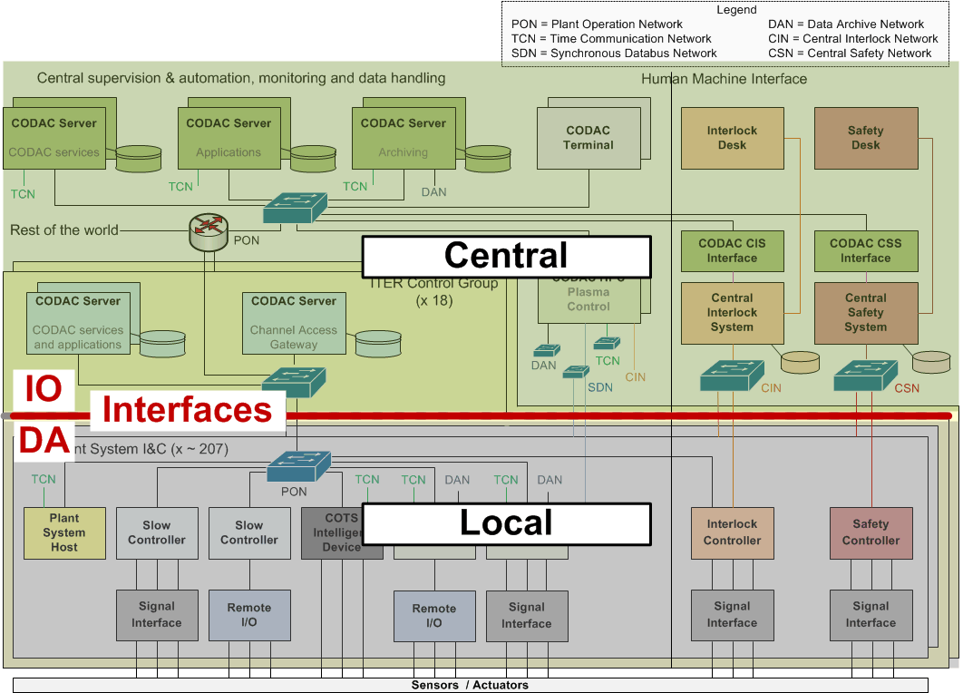
Architecture

Slide 10
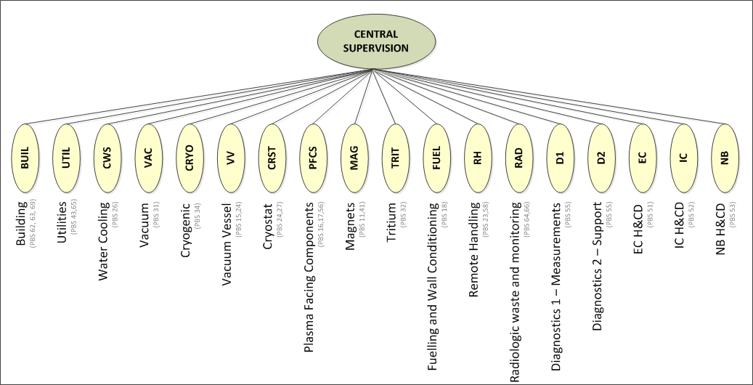
Architecture

Slide 11
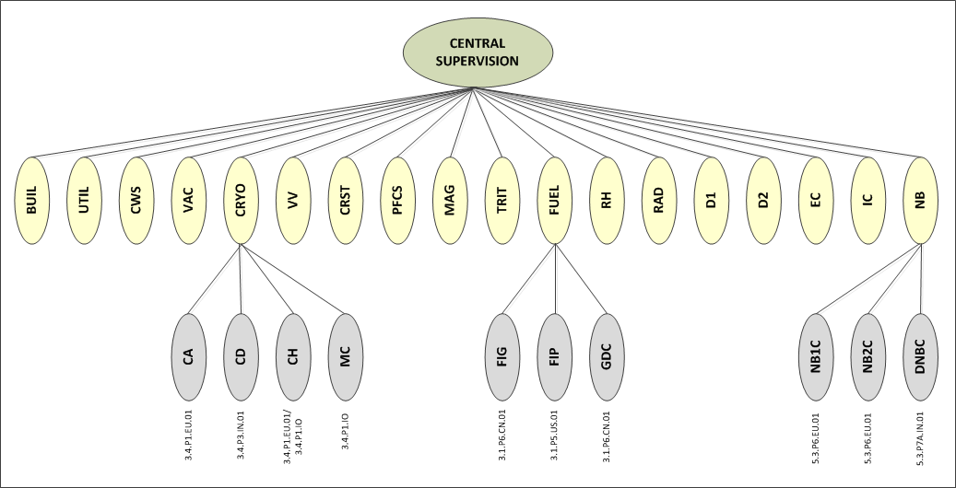
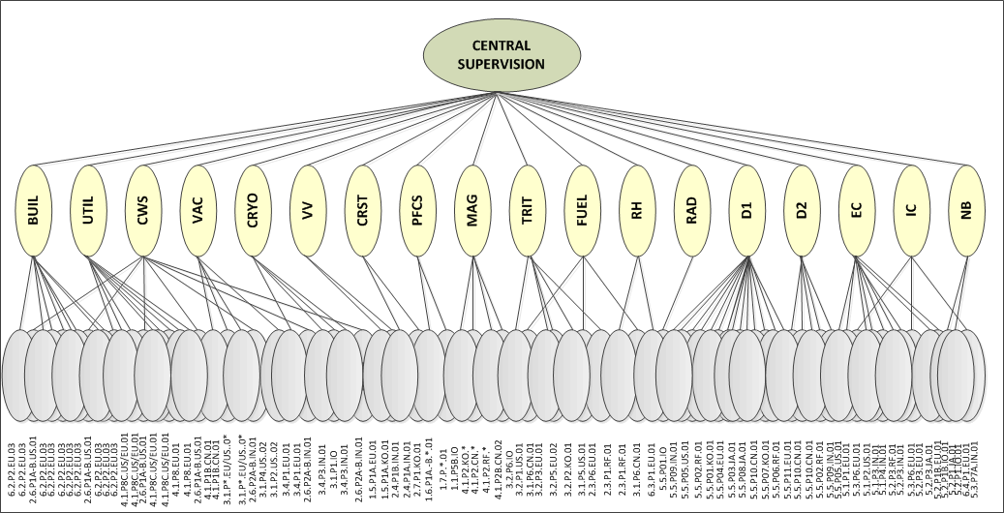
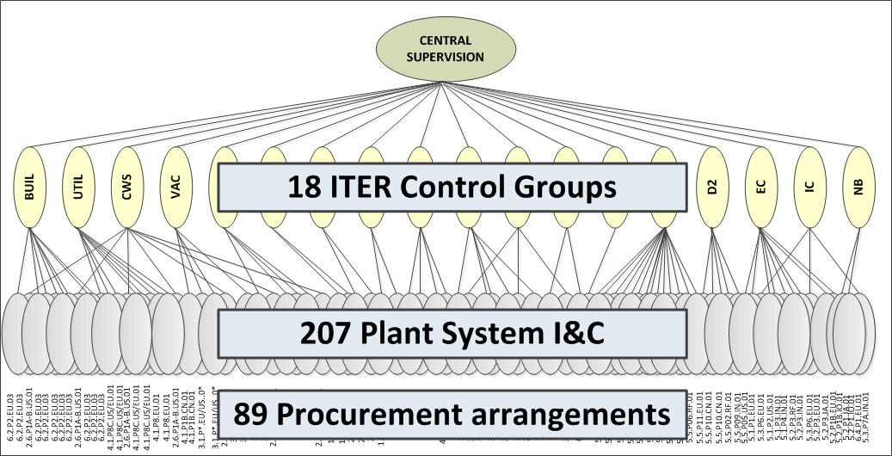
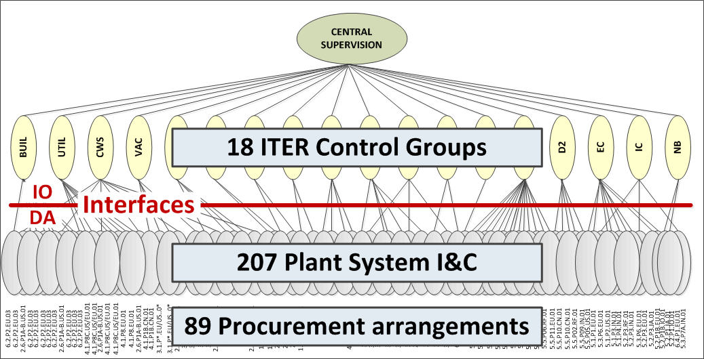
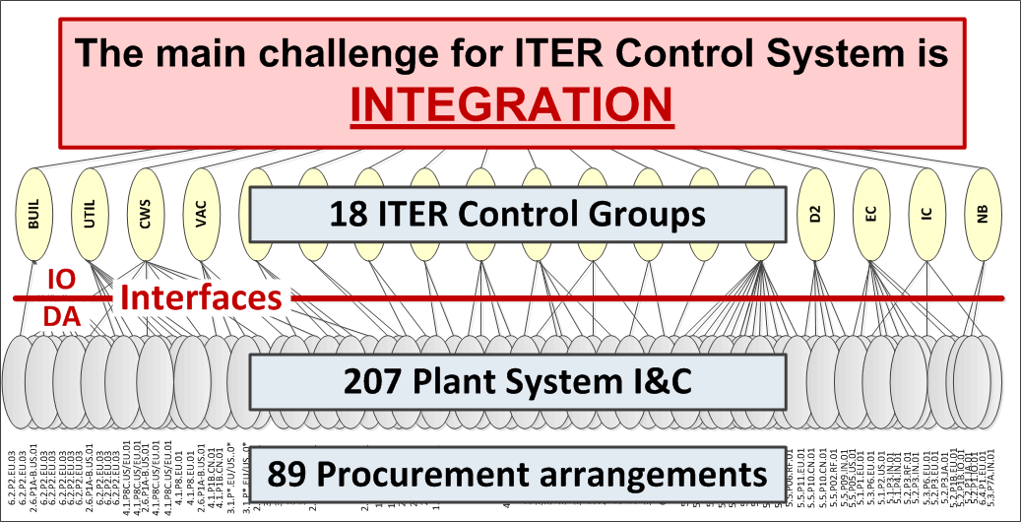
Architecture
ITER control system is broken down in 18 ITER control groups (CBS level 1)
An ITER control group contains many Plant System I&C (CBS level 2)
A Plant System I&C is a deliverable from a procurement arrangement (IN-KIND)
A procurement arrangement delivers a part, one or many Plant System I&C

Slide 12
Integration
The main challenge for ITER Control System is
INTEGRATION
MITIGATION
Define standards, specifications and interfaces applicable to all plant systems instrumentation and control (PCDH)
Develop and distribute a control system framework that implements standards defined in PCDH and guarantees that the local control system can be integrated into the central system (CODAC Core System)
Provide user support
Organize training; PCDH campaign,
CODAC Core System hands-on workshops
Provide I&C Integration Kit free of charge (PSH, Mini-CODAC, switch)
Demonstrate system on pilot projects

Slide 13
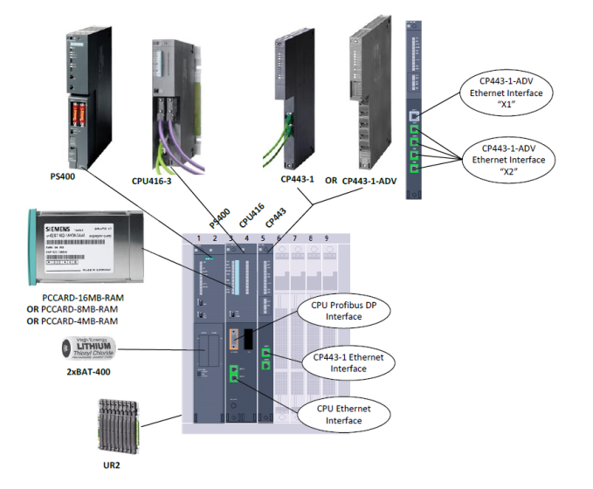
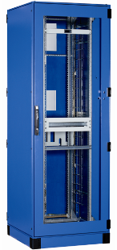
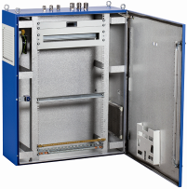
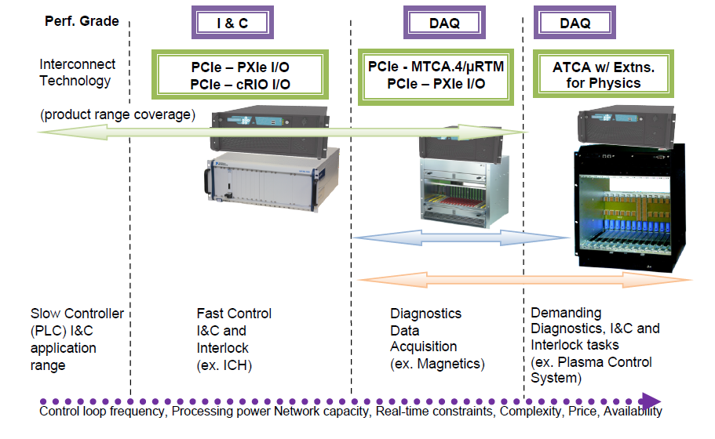
I&C standards – catalogue products
Slow control
Siemens S7-300 and S7-400 products
ET200M and ET200S for remote I/O
Covering standard industrial signals
Cubicles
Schneider Electric products
Address floor standing and wall mounted cubicles
Address Standard and EMC protected.
Fast control
PCI Express. CPU and I/O segregated
Mainly National Instruments products
Covering acquisition and control > 50 Hz

Slide 14



CODAC Core System: based on Open Source
The selected operating system is Red Hat Enterprise Linux for the x86-64 architecture (RHEL x86_64)
  The infrastructure layer is EPICS, used in hundreds of projects world-wide: light sources, high energy physics, fusion (KSTAR, NSTX), telescopes
  The CODAC services layer is Control System Studio used at many EPICS and other sites and including HMI, alarming, archiving etc.
  ITER specific software such as configuration (system description), state handling, drivers, networking, etc.
  6 month release cycle (major + minor release every year), extensive testing procedures

Slide 15
ITER Model of Plant System Integration
MRR = Manufacture Readiness Review
RFE = Building Ready For Equipment
IRR = Installation Readiness review
TRR = Test Readiness Review

Slide 16
Current Activities
CODAC Core System release: 5.0 (2015)
  RHEL 6.5
  EPICS Base 3.15
  EPICS V4 (evaluation only)
IO takes EPICS Support development responsibility
New S7 communication drivers
Design of real-time framework for plasma control
Design of pulse configuration system
Preparing tools to be used in FAT tests

Slide 17
What’s Next?
Continue development and support of CODAC Core System
Continue design of high level operation applications
Continue design of Interlock and Safety
Start implementing network infrastructure
Engage with users (plant system I&C developers)
Detail interfaces with plant system I&C
Develop integration schedule and procedures

Slide 18
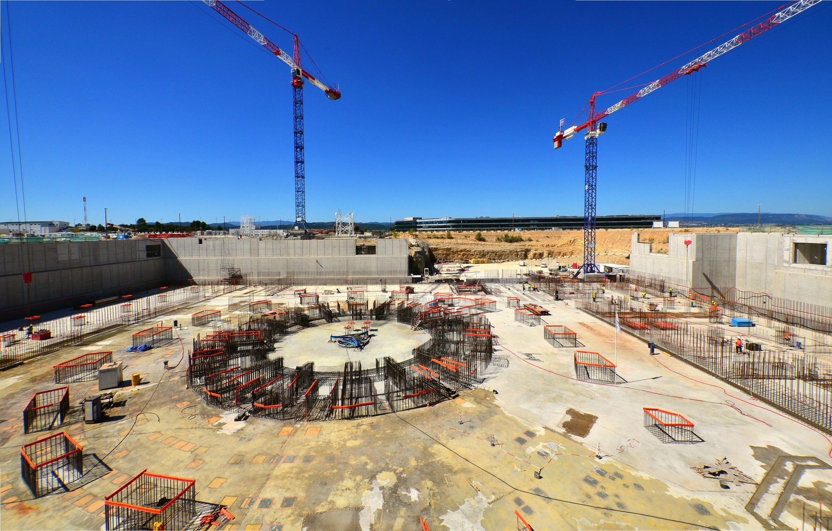
Thank you

